Slide 1
Informational App
By The Bread Boys

Slide 2
Project Criteria

Slide 3
Project Requirements
Needed to use various layouts.
Needed a main feature
Utilize multiple intents
Have a universal theme
Use Github

Slide 4
Concept

Slide 5
Brainstorming
We created an app about a fictional bakery named the bread boys
Provides important information about our different products
A tool to order our delicious loaves for pickup
A contacts page to store multiple intents

Slide 6
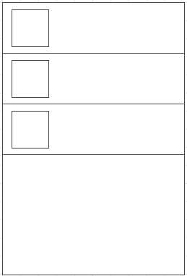
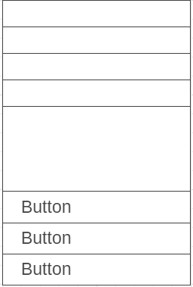
Designs
ViewPager to show a sample recipe
List View to contain our loaves
Google Material Standard Guidelines
Main Drawer Layout

Slide 7
Development

Slide 8
Timeline
Brainstorming
Main
Activity
Recipe
Page
Loaves &
Contact Page
Checkout & Settings Page
Testing &
Bug Fixing
Week 1
Week 2 - 4
Week 5
Week 6

Slide 9
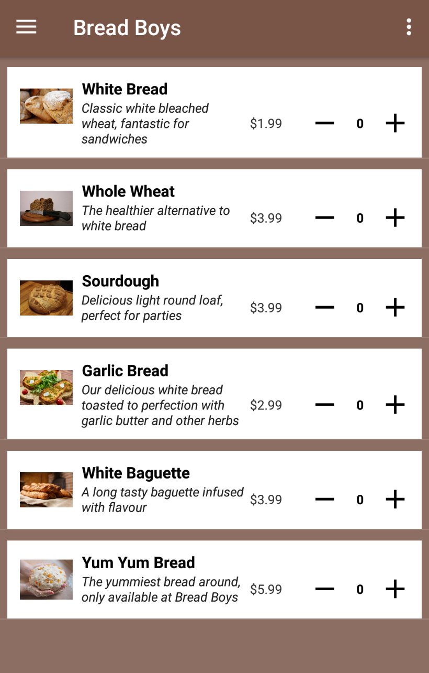
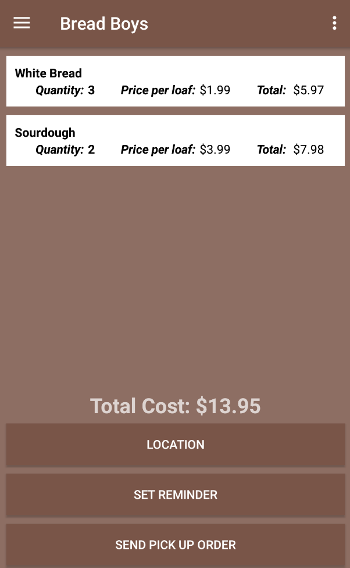
Concept
Final

Slide 10
Resources Used
Android Studio
Github
Pixabay
Stack Overflow

Slide 11
Issues
Custom Adapter was selecting the wrong ArrayList
Changed arraylist and created method to return items that have a quantity > 0
Checkout cart item list
Input handling error
Laggy listview
Created two else if statements that check for length, set EditText to numberField
Image sizes were too large
Got smaller image resolution sizes

Slide 12
App Demo

